Slide 1

Sir Syed University of Engineering & Technology, Karachi
CS-468 Software Quality Assurance & Testing
Week 7
Session 1

Slide 2
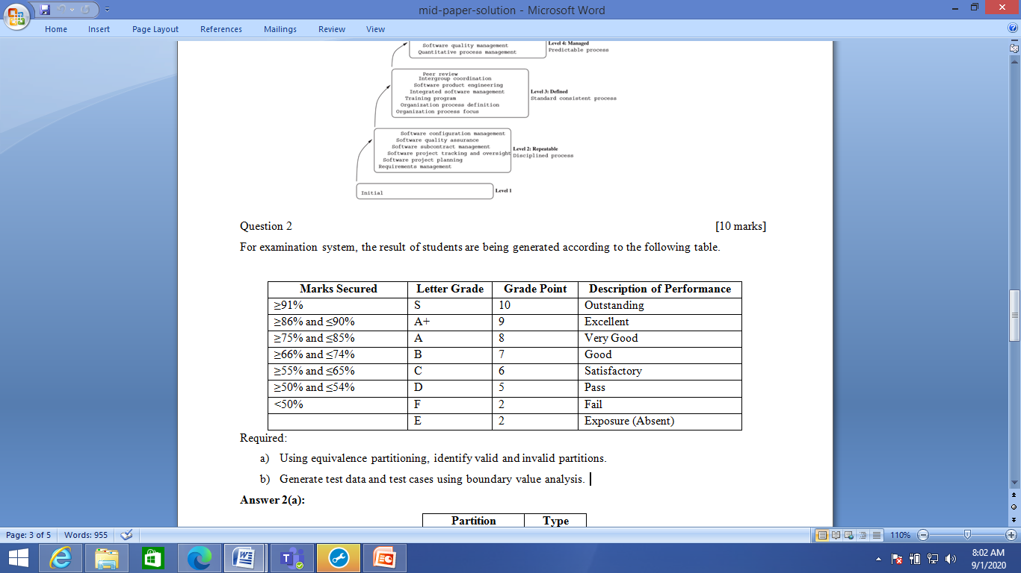
Equivalence Partitioning & Boundary Value Analysis –Case Study
For examination system, the result of students are being generated according to the following table.
Required:
Using equivalence partitioning, identify valid and invalid partitions.
Generate test data and test cases using boundary value analysis.

Slide 3
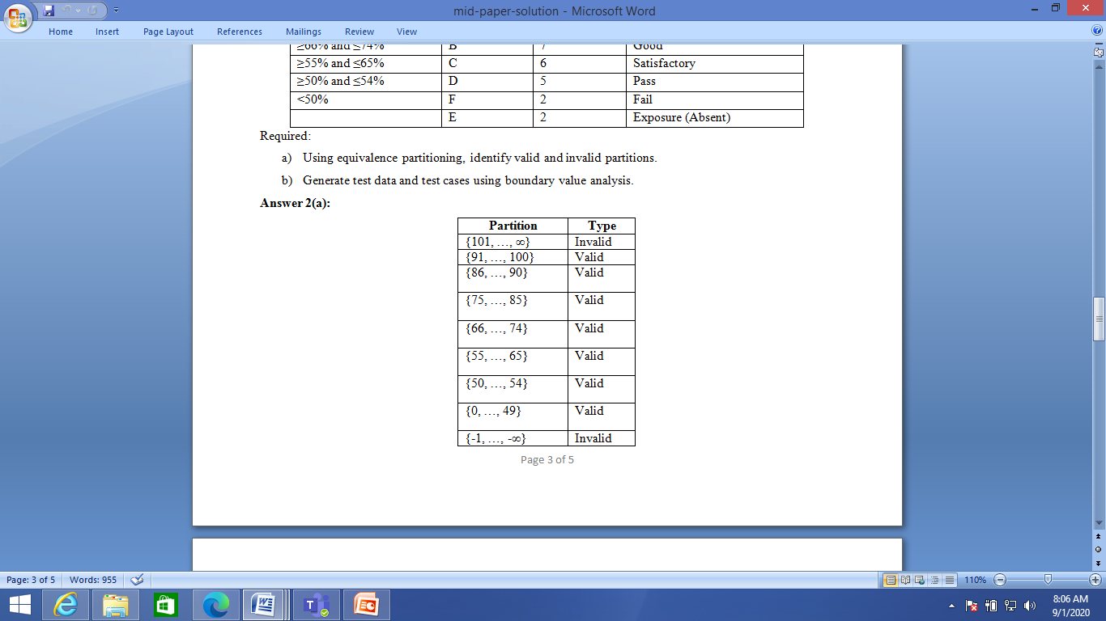
Equivalence Partitioning & Boundary Value Analysis –Case Study
Partitions:

Slide 4
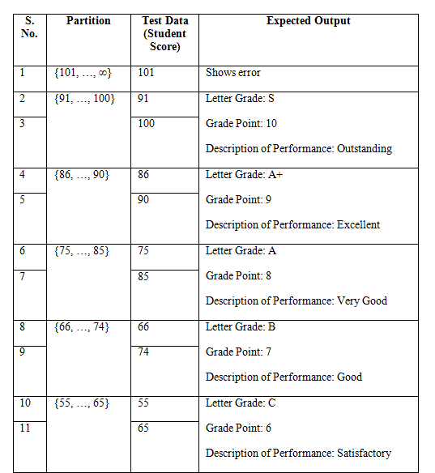
Equivalence Partitioning & Boundary Value Analysis –Case Study
Test data and test cases …:

Slide 5
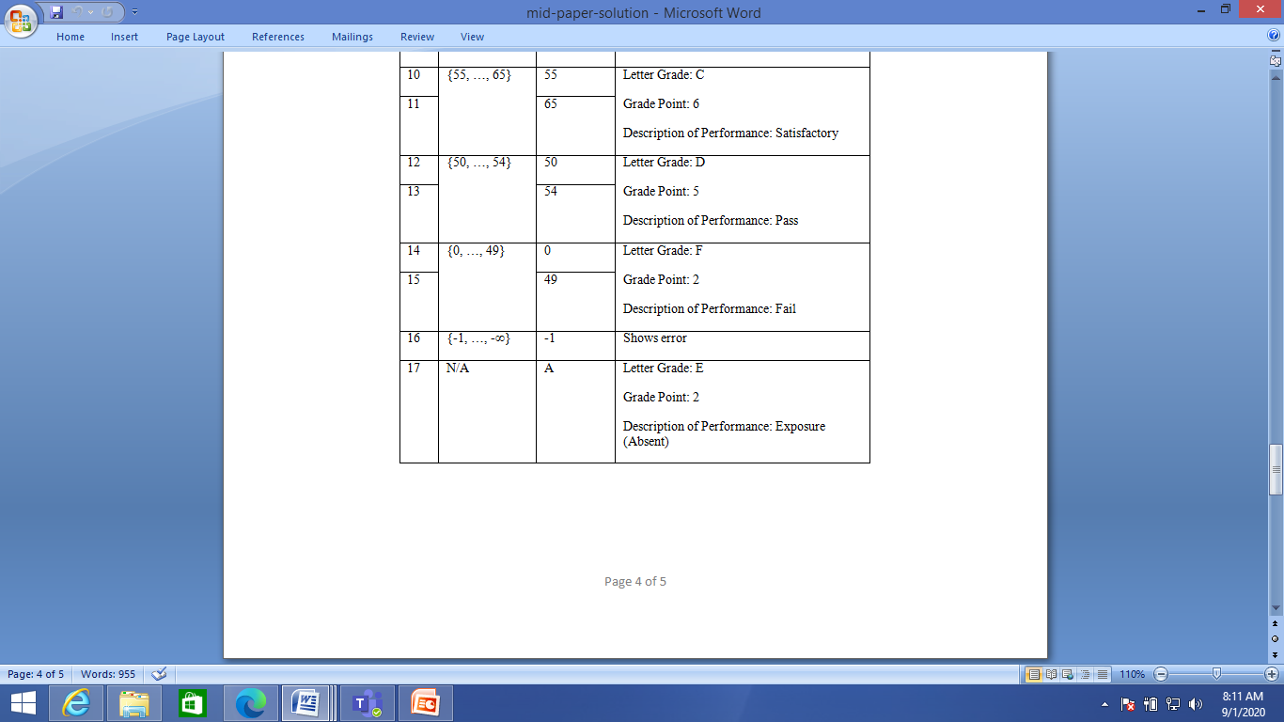
Equivalence Partitioning & Boundary Value Analysis –Case Study
….Test data and test cases:

Slide 6
The Psychology of testing …
A variety of different people may be involved in the total testing effort, and they may be drawn from a broad set of backgrounds.
Some will be developers, some professional testers, and some will be specialists, such as those with performance testing skills, whilst others may be users drafted in to assist with acceptance testing.
Who ever is involved in testing needs at least some understanding of the skills and techniques of testing to make an effective contribution to the overall testing effort.
Testing can be more effective if it is not undertaken by the individual(s) who wrote the code, for the simple reason that the creator of anything (whether it is software or a work of art) has a special relationship with the created object.
The nature of that relationship is such that flaws in the created object are rendered invisible to the creator. For that reason it is important that someone other than the creator should test the object.
Testers and developers think in different ways.

Slide 7
… The Psychology of testing …
Developers can test their own code, but it requires a mindset change, from that of a developer (to prove it works) to that of a tester (trying to show that it does not work).
If there are separate individuals involved, there are no potential conflicts of interest.
We therefore aim to have the software tested by someone who was not involved in the creation of the software; this approach is called test independence.
If a defect is found in software, the software author may see this as criticism.
Testers need to use tact and diplomacy when raising defect reports.
Defect reports need to be raised against the software, not against the individual who made the mistake.
The mistake may be in the code written, or in one of the documents upon which the code is based (requirement documents or system specification).
When we raise defects in a constructive way, bad feeling can be avoided.
As testers and developers, one of our goals is better quality systems delivered in a timely manner. Good communication between testers and the development teams is one way that this goal can be reached.

Slide 8
… The Psychology of testing
As testers and developers, one of our goals is better quality systems delivered in a timely manner.
Good communication between testers and the development teams is one way that this goal can be reached.
Testers and developers are not opposed, but working together, with the joint target of better quality systems.
Communication needs to be objective, and expressed in impersonal ways:
The aim is to work together rather than be confrontational. Keep the focus on delivering a quality product.
Results should be presented in a non-personal way. The work-product may be wrong, so say this in a non-personal way.
Attempt to understand how others feel; it is possible to discuss problems and still leave all parties feeling positive.

Slide 9
Code of ethics …
Testers must adhere to a code of ethics: they are required to act in a professional manner.
Testers can have access to confidential and/or privileged information, and they are to treat any information with care and attention, and act responsibly to the owner(s) of this information, employers and the wider public interest.
Of course, anyone can test software, so the declaration of this code of conduct applies to those who have achieved software testing certification! The code of ethics applies to the following areas:
Public – Certified software testers shall consider the wider public interest in their actions.
Client and employer – Certified software testers shall act in the best interests of their client and employer (being consistent with the wider public interest).
Product – Certified software testers shall ensure that the deliverables they provide (for any products and systems they work on) meet the highest professional standards possible.

Slide 10
… Code of ethics
Judgement – Certified software testers shall maintain integrity and independence in their professional judgement.
Management – Certified software test managers and leaders shall subscribe to and promote and ethical approach to the management of software testing.
Profession – Certified software testers shall advance the integrity and reputation of the profession consistent with the public interest.
Colleagues – Certified software testers shall be fair to and supportive of their colleagues, and promote cooperation with software developers.
Self – Certified software testers shall participate in lifelong learning regarding the practice of their profession, and shall promote an ethical approach to the practice of the profession.

